Slide 1
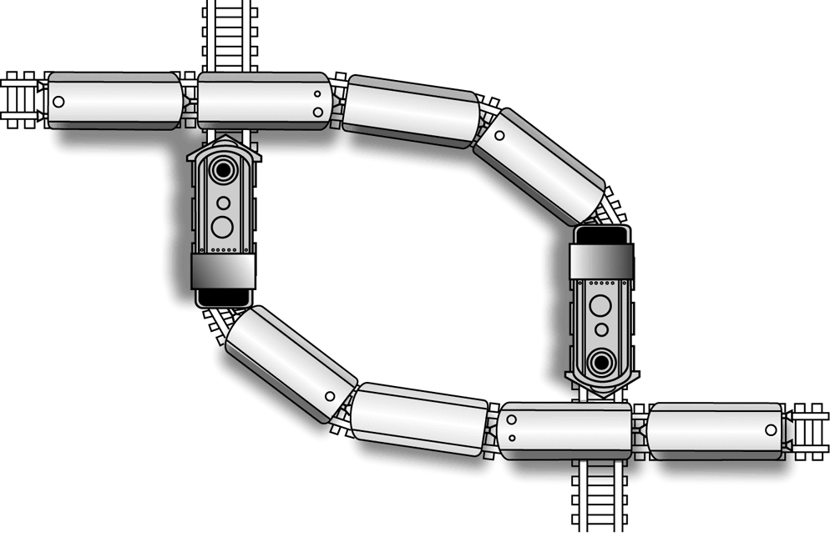

CS-3103 : Operating Systems : Sec-A (NB) :
Deadlocks…..
Operating System Concepts

Slide 2
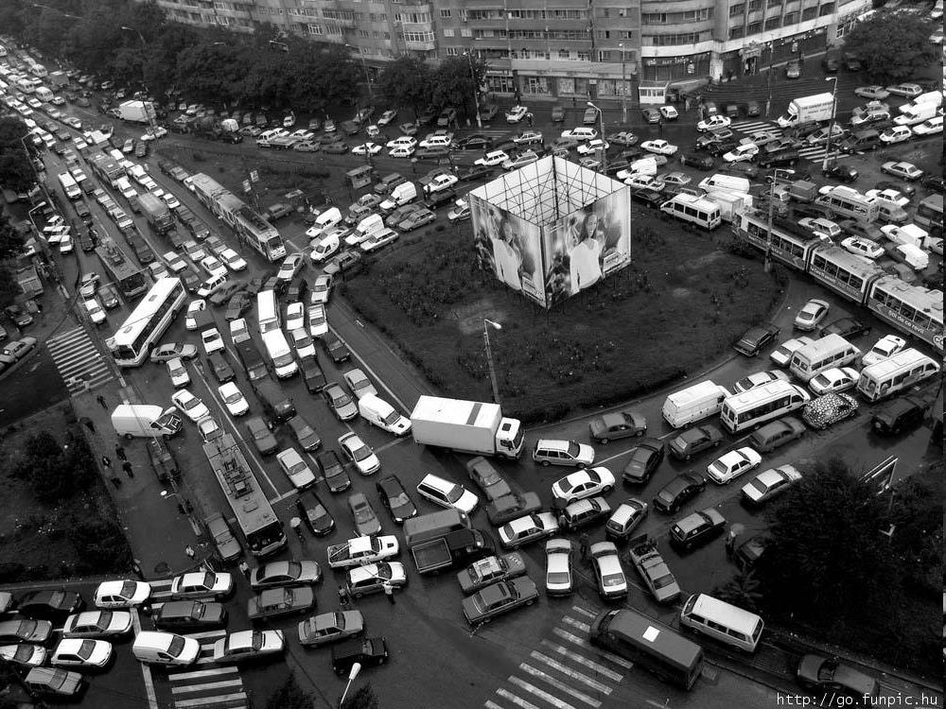
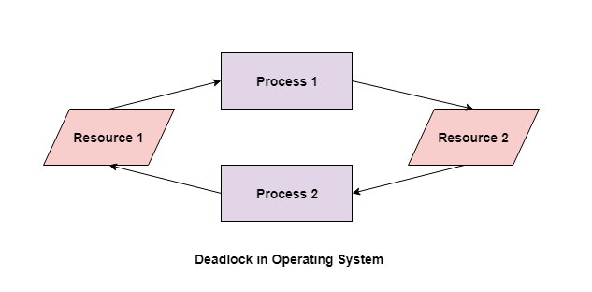
Operating System Concepts

Slide 3
CSEN3103: 3RD YEAR: SEC-A: Deadlocks
System Model
Deadlock Characterization
Methods for Handling Deadlocks
Deadlock Prevention
Deadlock Avoidance
Deadlock Detection
Recovery from Deadlock
Combined Approach to Deadlock Handling
Operating System Concepts

Slide 4

Approaching Deadlock……
Let us consider the following scenario:
A process P1 is in execution. It requests for a printer. The operating system allocates the printer to process P1. A context switch happens: Process P1 is now in possession of the printer, but it has relinquished the CPU. The CPU is allotted to another process, P2. The process P2 now requests for the printer….
In this situation, for the moment, neither P1 nor P2 can progress, because P1 has the printer but needs the CPU to generate data.
On the other hand P2 has the CPU and can generate data, but needs the printer to print it.
We can say, both processes P1 and P2 are blocked at the moment and are in a deadlock situation.
Deadlock is a situation in a computer system, where a set of processes is blocked, waiting for an event which will never happen.
Starvation can be defined as a situation where a process waits for a resource, which is, for a prolonged time, made available to other processes.
Operating System Concepts

Slide 5
The Deadlock Problem
A set of blocked processes each holding a resource and waiting to acquire a resource held by another process in the set. Couple of examples:
Example -1
  System has 2 printers.
  P₁ and P₂ each hold one printer and each needs another one.
Example-2
  semaphores A and B, initialized to 1
        P₁ P₂
        wait (A); wait(B)
        wait (B); wait(A)
Operating System Concepts

Slide 6
DEADLOCK – Let’s talk about Resource allocation to processes
A computer system has 6 tape drives with n processes competing for them. Each process need 2 tape drives. The maximum value for n for which the system is guaranteed to be deadlock free is: a) 6 b) 5 c) 4 d) 3
5 processes can start with 1 tape drive (each). Processes are executing sequentially in the following way:
2 allocate
1
1
1
1
No Deadlock
P1
P2
P3
P4
P5
2 free
3 free
4 free
5 free
6 free
Operating System Concepts

Slide 7
System Model
Resource types R₁, R₂, . . ., R_{m}
    CPU cycles, memory space, I/O devices
Each resource type R_{i} has W_{i} instances.
Each process utilizes a resource as follows:
  request
  use
  release
Operating System Concepts

Slide 8

Necessary conditions (Coffman Conditions) for a Deadlock to occur
Deadlock can arise if the following four conditions hold simultaneously.
Mutual exclusion: A major cause of deadlock is that some resources are not shareable. Therefore, only one process can access such a resource at a time. This is a case of mutual exclusion, where, competing processes mutually exclude each other for the usage of the resource. Example: the chopstick is a non-shareable resource and therefore no two philosophers can simultaneously use the same chopstick.
There should be a resource that can only be held by one process at a time. In the diagram below, there is a single instance of Resource 1 and it is held by Process 1 only.
Operating System Concepts

Slide 9
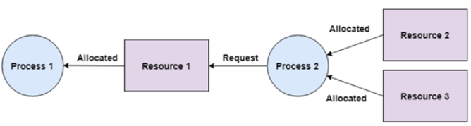
Necessary conditions (Coffman Conditions) for a Deadlock to occur
Hold and wait: a process holding at least one resource is waiting to acquire additional resources held by other processes. This means a process can hold multiple resources and still request more resources from other processes which are holding them. In the diagram given below, Process 2 holds Resource 2 and Resource 3 and is requesting the Resource 1 which is held by Process 1.
Operating System Concepts

Slide 10
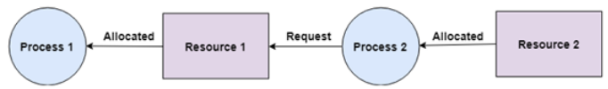
Necessary conditions (Coffman Conditions) for a Deadlock to occur
No preemption: a resource can be released only voluntarily by the process holding it, after that process has completed its task. A resource cannot be preempted from a process by force. A process can only release a resource voluntarily. In the diagram below, Process 2 cannot preempt Resource 1 from Process 1. It will only be released when Process 1 relinquishes it voluntarily after its execution is complete.
Operating System Concepts

Slide 11
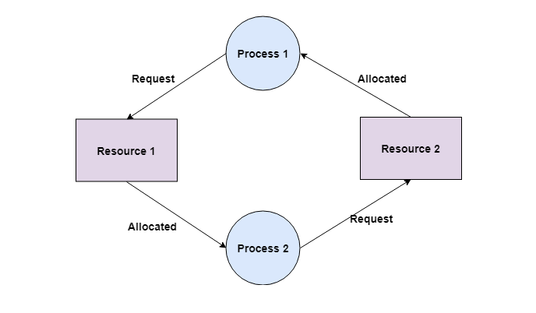
Necessary conditions (Coffman Conditions) for a Deadlock to occur
Circular wait: there exists a set {P₀, P₁, …, P₀} of waiting processes such that P₀ is waiting for a resource that is held by P₁, P₁ is waiting for a resource that is held by P₂, …, P_{n–1} is waiting for a resource that is held by P_{n}, and P₀ is waiting for a resource that is held by P₀.
Operating System Concepts

Slide 12
Resource-Allocation Graph
A set of vertices V and a set of edges E.
V is partitioned into two types:
  P = {P₁, P₂, …, P_{n}}, the set consisting of all the processes in the system.
  R = {R₁, R₂, …, R_{m}}, the set consisting of all resource types in the system.
request edge – directed edge P₁ → R_{j}
assignment edge – directed edge R_{j} → P_{i}
Operating System Concepts

Slide 13

Resource-Allocation Graph (Cont.)
Process
Resource Type with 4 instances
P_{i} requests instance of R_{j}
P_{i} is holding an instance of R_{j}
R_{j}
P_{i}
P_{i}
R_{j}
Operating System Concepts

Slide 14

Example of a Resource Allocation Graph (Deadlock???)
requesting
Allocated
Free
Operating System Concepts

Slide 15

Resource Allocation Graph (Deadlock ???)
Operating System Concepts

Slide 16

Resource Allocation Graph (Deadlock ???)
P1→R1→P3→R2→P1
Operating System Concepts

Slide 17
Basic Facts
Cycle is there: P1→R1→P3→R2→P1
But, there is no deadlock. Process P4 may release its instance of resource type R2. That resource can then be allocated to P3, breaking the cycle.
If graph contains no cycles ⇒ no deadlock.
If graph contains a cycle ⇒
  if only one instance per resource type, then deadlock.
  if several instances per resource type, possibility of deadlock.
Operating System Concepts

Slide 18
Methods for Handling Deadlocks
Ensure that the system will never enter a deadlock state.
Allow the system to enter a deadlock state and then recover.
Ignore the problem and pretend that deadlocks never occur in the system; used by most operating systems, including UNIX.
Operating System Concepts

Slide 19
Deadlock Strategies
The deadlock problem is handled by using the following strategies:
  Deadlock detection
  Deadlock prevention
  Deadlock avoidance
Operating System Concepts

Slide 20
Deadlock Detection
A deadlock can be detected by a resource scheduler as it keeps track of all the resources that are allocated to different processes. After a deadlock is detected, it can be resolved using the following methods:
All the processes that are involved in the deadlock are terminated. This is not a good approach as all the progress made by the processes is destroyed.
Resources can be preempted from some processes and given to others till the deadlock is resolved.
Deadlock Prevention
It is very important to prevent a deadlock before it can occur. So, the system checks each transaction before it is executed to make sure it does not lead to deadlock. If there is even a slight chance that a transaction may lead to deadlock in the future, it is never allowed to execute.
Deadlock Avoidance
It is better to avoid a deadlock rather than take measures after the deadlock has occurred. The wait for graph can be used for deadlock avoidance. This is however only useful for smaller databases as it can get quite complex in larger databases.
Operating System Concepts

Slide 21
Deadlock Prevention
Restrain the ways request can be made.
Mutual Exclusion – not required for sharable resources; must hold for non-sharable resources example. printer.
Hold and Wait – must guarantee that whenever a process requests a resource, it does not hold any other resources.
  Require process to request and be allocated all its resources before it begins execution, or allow process to request resources only when the process has none.
  Low resource utilization; starvation possible.
Operating System Concepts

Slide 22
Deadlock Prevention (Cont.)
No Preemption –
  If a process that is holding some resources requests another resource that cannot be immediately allocated to it, then all resources currently being held are released.
  Preempted resources are added to the list of resources for which the process is waiting.
  Process will be restarted only when it can regain its old resources, as well as the new ones that it is requesting.
  Adopt a policy wherein the resources allocated to a process can be preempted by the operating system. However, sometimes cost of preemption becomes very high. For instance, the resources like printers, plotters, etc., should not be forcefully taken by the OS from an executing process. In contrast, preempting a CPU for a short duration is tolerable.
Circular Wait – impose a total ordering of all resource types, and require that each process requests resources in an increasing order of enumeration.
Operating System Concepts

Slide 23
Deadlock Avoidance
Requires that the system has some additional a priori information available.
Simplest and most useful model requires that each process declare the maximum number of resources of each type that it may need.
The deadlock-avoidance algorithm dynamically examines the resource-allocation state to ensure that there can never be a circular-wait condition.
Resource-allocation state is defined by the number of available and allocated resources, and the maximum demands of the processes.
Operating System Concepts

Slide 24
Safe State
When a process requests an available resource, system must decide if immediate allocation leaves the system in a safe state.
System is in safe state if there exists a safe sequence of all processes.
Sequence <P₁, P₂, …, P_{n}> is safe if for each P_{i}, the resources that Pi can still request can be satisfied by currently available resources + resources held by all the P_{j}, with j<i.
  If P_{i} ‘s resource needs are not immediately available, then P_{i} can wait until all P_{j} have finished.
  When P_{j} is finished, P_{i} can obtain needed resources, execute, return allocated resources, and terminate.
  When P_{i} terminates, P_{i+1} can obtain its needed resources, and so on.
Operating System Concepts

Slide 25
Basic Facts
If a system is in safe state ⇒ no deadlocks.
If a system is in unsafe state ⇒ possibility of deadlock.
Avoidance ⇒ ensure that a system will never enter an unsafe state.
Operating System Concepts

Slide 26

Safe, unsafe , deadlock state spaces
Operating System Concepts

Slide 27
Resource-Allocation Graph Algorithm
Claim edge P_{i} R_{j} indicated that process P_{i} may request resource R_{j}; represented by a dashed line.
Claim edge converts to request edge when a process requests a resource.
When a resource is released by a process, assignment edge reconverts to a claim edge.
Resources must be claimed a priori in the system.
Operating System Concepts

Slide 28

Resource-Allocation Graph For Deadlock Avoidance
Claim
Claim
Operating System Concepts

Slide 29

Unsafe State In A Resource-Allocation Graph
Allocated
Operating System Concepts

Slide 30
Banker’s Algorithm (the deadlock avoidance algorithm)
Multiple instances.
Each process must a priori claim maximum use.
When a process requests a resource it may have to wait.
When a process gets all its resources it must return them in a finite amount of time.
Operating System Concepts

Slide 31
Data Structures for the Banker’s Algorithm
Let n = number of processes, and m = number of resources types.
Available: Vector of length m. If available [j] = k, there are k instances of resource type R_{j} available.
Max: n x m matrix. If Max [i,j] = k, then process P_{i} may request at most k instances of resource type R_{j}.
Allocation: n x m matrix. If Allocation[i,j] = k then P_{i} is currently allocated k instances of R_{j.}
Need: n x m matrix. If Need[i,j] = k, then P_{i} may need k more instances of R_{j} to complete its task.
    Need [i,j] = Max[i,j] – Allocation [i,j].
Operating System Concepts

Slide 32
Safety Algorithm
1. Let Work and Finish be vectors of length m and n, respectively. Initialize:
      Work := Available
      Finish [i] = false for i - 1,2,3, …, n.
2. Find an i such that both:
  (a) Finish [i] = false
  (b) Need_{i} ≤ Work
  If no such i exists, go to step 4.
3. Work := Work + Allocation_{i}
Finish[i] := true
go to step 2.
4. If Finish [i] = true for all i, then the system is in a safe state.
Operating System Concepts

Slide 33
Resource-Request Algorithm for Process P_{i}
Request_{i} = request vector for process P_{i}. If Request_{i} [j] = k then process P_{i} wants k instances of resource type R_{j.}
  1. If Request_{i} ≤ Need_{i} go to step 2. Otherwise, raise error condition, since process has exceeded its maximum claim.
  2. If Request_{i} ≤ Available, go to step 3. Otherwise P_{i} must wait, since resources are not available.
  3. Pretend to allocate requested resources to P_{i} by modifying the state as follows:
      Available := Available = Request_{i};
      Allocation_{i} := Allocation_{i} + Request_{i};
      Need_{i} := Need_{i} – Request_{i;}
    If safe ⇒ the resources are allocated to P_{i}.
    If unsafe ⇒ P_{i} must wait, and the old resource-allocation state is restored
Operating System Concepts

Slide 34
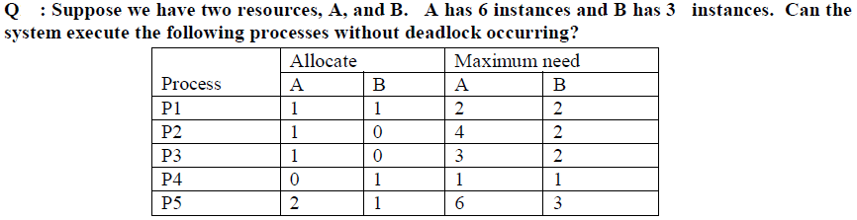
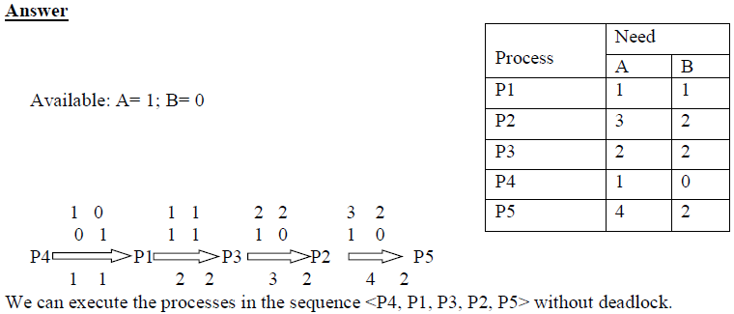
Example of Banker’s Algorithm
Sum of max. need per row.
Already Allocated
4
6
5
2
9
Min.
Available: A → 6 instances, Already allocated → 5; available → 6-5 = 1; For B → 0 , no instances are available
Total freed up resources can be allocated to awaiting processes.. Starting from P4 → P1 → P3 → P2 → P5…. Total can fulfill the need….
Allocated
Need
total
Operating System Concepts

Slide 35
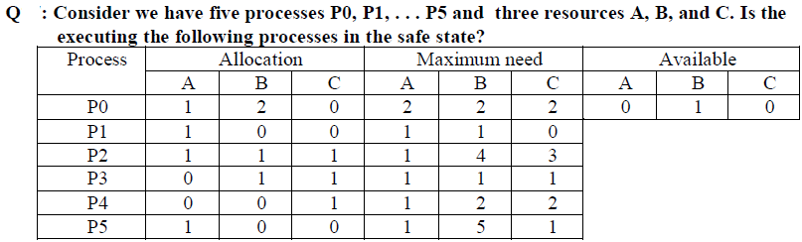
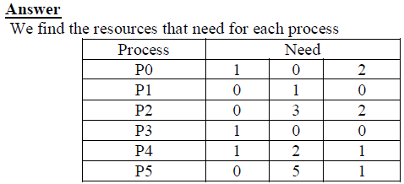
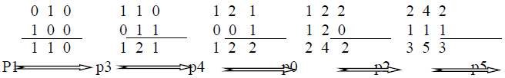
Allocation
Operating System Concepts

Slide 36
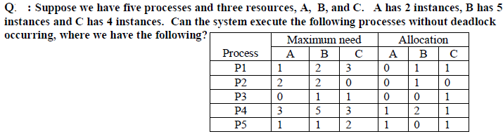
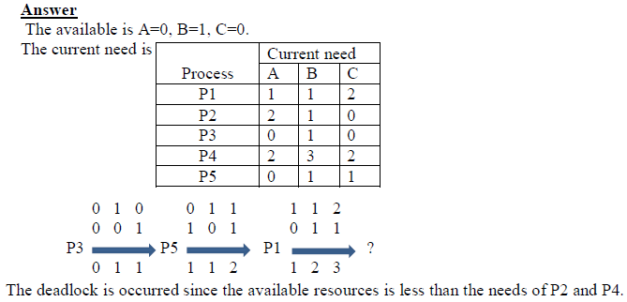
Operating System Concepts

Slide 37
Example of Banker’s Algorithm
5 processes P₀ through P₄; 3 resource types A (10 instances), B (5 instances), and C (7 instances).
Snapshot at time T₀:
Allocation Max Available
A B C A B C A B C
P₀ 0 1 0 7 5 3 3 3 2
P₁ 2 0 0 3 2 2
P₂ 3 0 2 9 0 2
P₃ 2 1 1 2 2 2
P₄ 0 0 2 4 3 3
Operating System Concepts

Slide 38
Example (Cont.)
Need is defined to be (Max – Allocation).
Need
A B C
P₀ 7 4 3
P₁ 1 2 2
P₂ 6 0 0
P₃ 0 1 1
P₄ 4 3 1
The system is in a safe state since the sequence < P₁, P₃, P₄, P₂, P₀> satisfies safety criteria.
Operating System Concepts

Slide 39
Example (Cont.): P₁ request (1,0,2)
Check that Request ≤ Available (that is, (1,0,2) ≤ (3,3,2) ⇒ true.
Allocation Need Available
A B C A B C A B C
P₀ 0 1 0 7 4 3 2 3 0
P₁ 3 0 2 0 2 0
P₂ 3 0 1 6 0 0
P₃ 2 1 1 0 1 1
P₄ 0 0 2 4 3 1
Executing safety algorithm shows that sequence <P₁, P₃, P₄, P₀, P₂> satisfies safety requirement.
Can request for (3,3,0) by P₄ be granted?
Can request for (0,2,0) by P₀ be granted?
Operating System Concepts

Slide 40

Operating System Concepts

